Slide 1

Monday 2nd March

Slide 2

“Everything she needs is within herself”
Rupi Kaur

Slide 3

“Everything she needs is within herself” Rupi Kaur
March 8th is International Women’s Day
Rupi Kaur (born October 4, 1992) is a Canadian poet, illustrator, and performer known for her short, emotionally direct poems paired with minimalist line drawings. Born in Punjab, India, and raised in Canada, she began sharing her work on Instagram, where her accessible style quickly gained global attention.

Slide 4
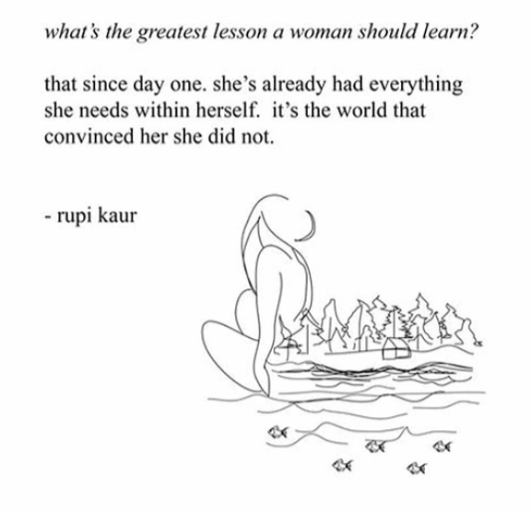
International Women’s Day – March 8th
Discussion Questions
What is the main message of Rupi’s poem? How does it link to resilience?
In what ways might she be suggesting the world has impacted women's ambition?
Why are days like International Women’s Day so important in ensuring everyone is treated with respect?

Slide 5

Trip Opportunity For Year 9 – April 27th!
We are excited to be launching a year 9 residential opportunity on 27th April this year.
We have been awarded a charitable grant which meant the opportunity was too good to pass up on.
Please see Mrs Stewart or Miss Pearson if you have any questions

Slide 6
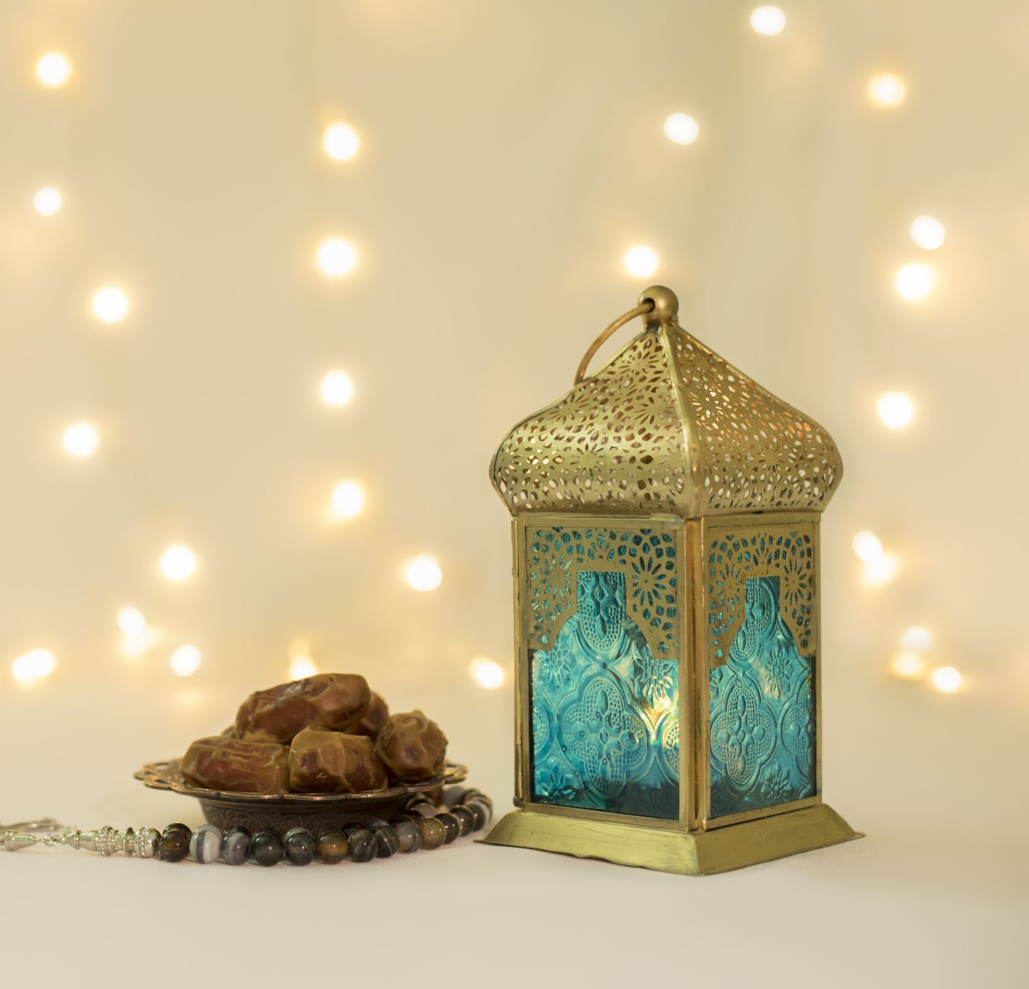
Ramadan 17th Feb – 19th March
During Ramadan, some staff and students in our community are observing Ramadan which means that they are observing lots of practices which have a big impact on their lives.
It can include the following
Fasting between dawn and dusk – this mean not drinking or eating between different times – these change each day
Waking up very early in the morning to pray
Abstaining from any bad habits (trying to) such as, gossiping, swearing, derogatory comments, cruelty or rudeness

Slide 7
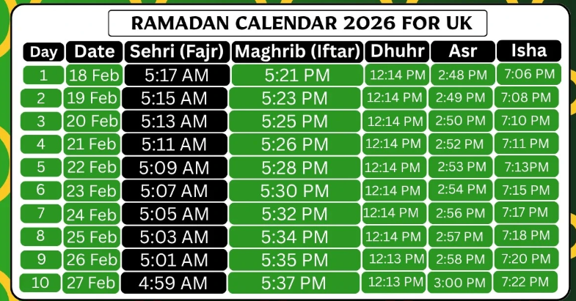
Fasting
The fasting timetable changes each day, and many Muslims observe prayer prior to eating, so can be feeling incredibly tired and lacking in energy
As you can see from the timetable this year, lots of people in our community are waking up very early
Fajr – First daily prayer

Slide 8
How to support members of our community who are observing Ramadan
Things we can do
Refrain from bad language as this can be particularly offensive at this time
Be mindful that people around us may be very hungry, or tired
Ask questions about Ramadan, students will usually be happy to talk about it as it is an incredibly special time for them
Things we should not do
Question why someone is not observing Ramadan
Question someone's conduct during Ramadan
Tease people with food

Slide 9


Slide 10
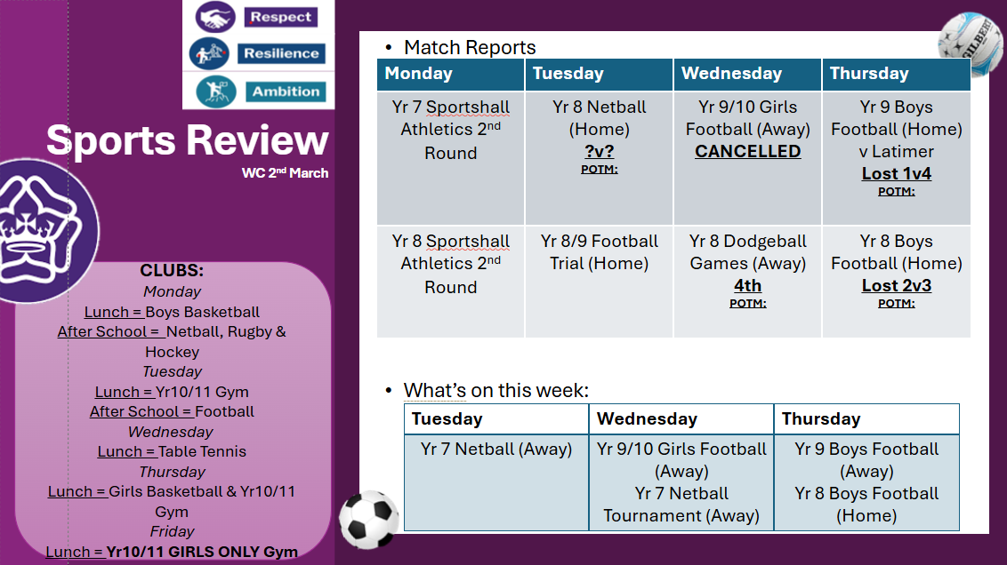

Slide 11

World Book Day
Y7 and 8 - get one from your tutor!
Extras available in the library
Books available from Oundle Bookshop / The Works / Asda / Tesco / Sainsburys
From 12 February

Slide 12

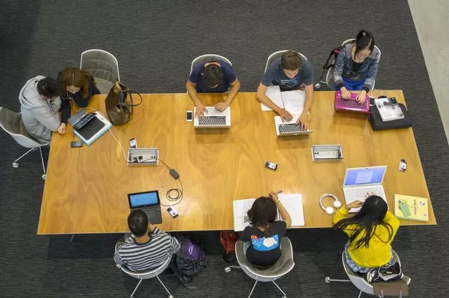
Homework Club
Do you have work that you would prefer to do in school, rather than when you get home and just want to relax?
Why not try homework club?
It offers a warm and quiet place to finish off work or revise for upcoming tests especially through the cold and wet winter months!
Why not try it out?
Just ask your tutor, or your subject teacher to add you to the register for a particular day to secure your spot in the warm!!
Any year- any time; break or lunch!
Computers available!

Slide 13
New After School Homework Club
Do you have work that you would prefer to do in school, rather than when you get home and just want to relax?
Why not try homework club?
It offers a warm, supervised and quiet place to finish off work or revise for upcoming tests especially through the cold and wet winter months!
This new club will be available Monday to Wednesday in the Library after school but you must secure your place via Arbor sign up.
Any year
Computers available!

Slide 14


Slide 15


Slide 16


Slide 17




Slide 18

THURSDAY 26TH MARCH
3:40PM – 5:40PM
Do you have the talent to wow the judges? Could you be the next Taylor Swift or Peter Kay? Want to sign up? Follow this link:
https://forms.gle/GmMjnjH39CyVNnew5
All students have been sent this on their Edulink!
JUST ONE MORE WEEK TO ENTER!

Slide 19

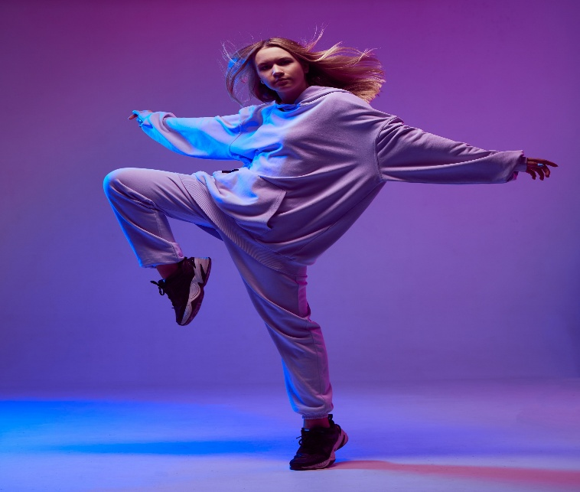

We have had an amazing 25 students sign up for the Talent Show so far!
ACTS TO INCLUDE:
SINGING DANCING LIP SYNCING RUBIK’S CUBING
MUSICIANS COMEDIANS & MORE
IF YOU DON’T WANT TO TAKE PART, BUT WOULD LIKE TO BE PART OF THE AUDIENCE FOR THE TALENT SHOW, TICKETS WILL BE AVAILABLE VERY SOON AND ARE COMPLETELY FREE! THESE ARE LIKELY TO BE ISSUED ON A FIRST COME FIRST SERVE BASIS, SO DON’T MISS OUT!

Slide 20
Week 3 - Eco Challenge: Recycling Drive
Theme: Responsibility & Respect
Activity: Dry Recycling Collection Challenge – your form is tasked with collecting recyclable items over the course of the week.
Accepted items: paper, cardboard, plastic bottles, cans.
As a form you will need to agree your ‘recycling targets’ for the week
Scoring
Quantity: 10 points per bag/box of correctly sorted recycling
Bonus: Most resilient form: +25 pts
Values Alignment
Respect: Careful sorting and environmental responsibility
Resilience: Sustained effort throughout the week
GET COLLECTING THIS WEEK!

Slide 21

HAPPENING THIS WEEK…
YEAR 7 MINI DUCK TREASURE HUNT
DATE: FRIDAY 6TH MARCH
TIME: 9AM-9:15AM (DURING FORM TIME)
CHALLENGE: FIND AS MANY MINI YELLOW DUCKS AS YOU CAN AROUND THE SCHOOL SITE AND RETURN THEM TO YOUR FORM TUTOR.
DUCKS WILL BE LOCATED IN OUTSIDE AREAS ONLY
THE HOUSE THAT FINDS THE LARGEST NUMBER OF DUCKS WINS!

Slide 22

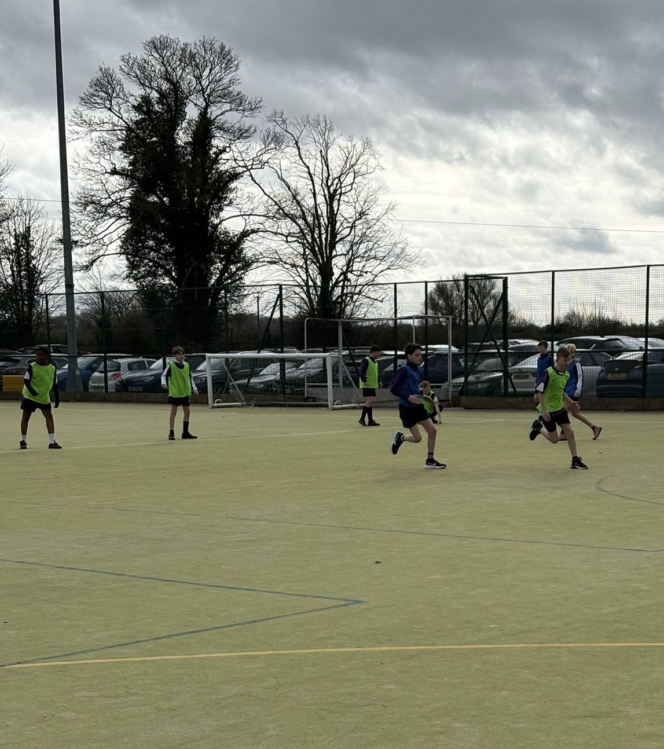
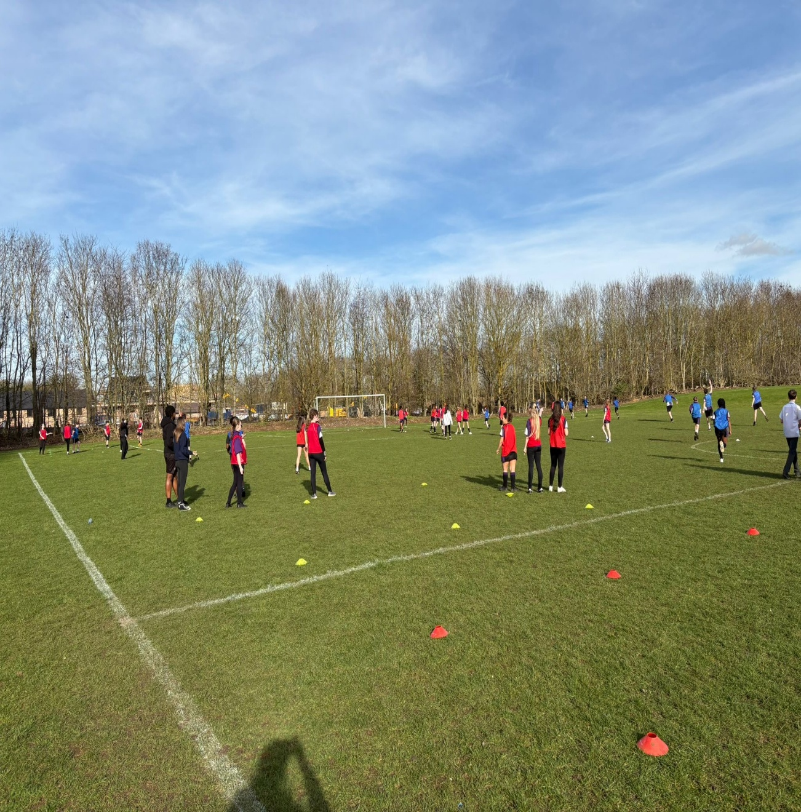
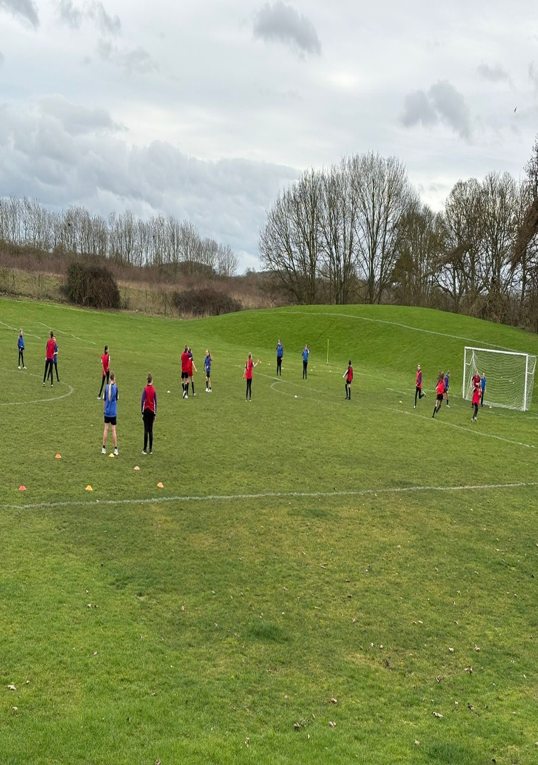
Key Stage 3 Capture the flag competitions update
Key stage 3 students have been busy in lessons this week taking part in inter-house capture the flag in their PE lessons. The competitions will come to an end next week and results will be shared – well done so far & good luck to all involved!

Slide 23
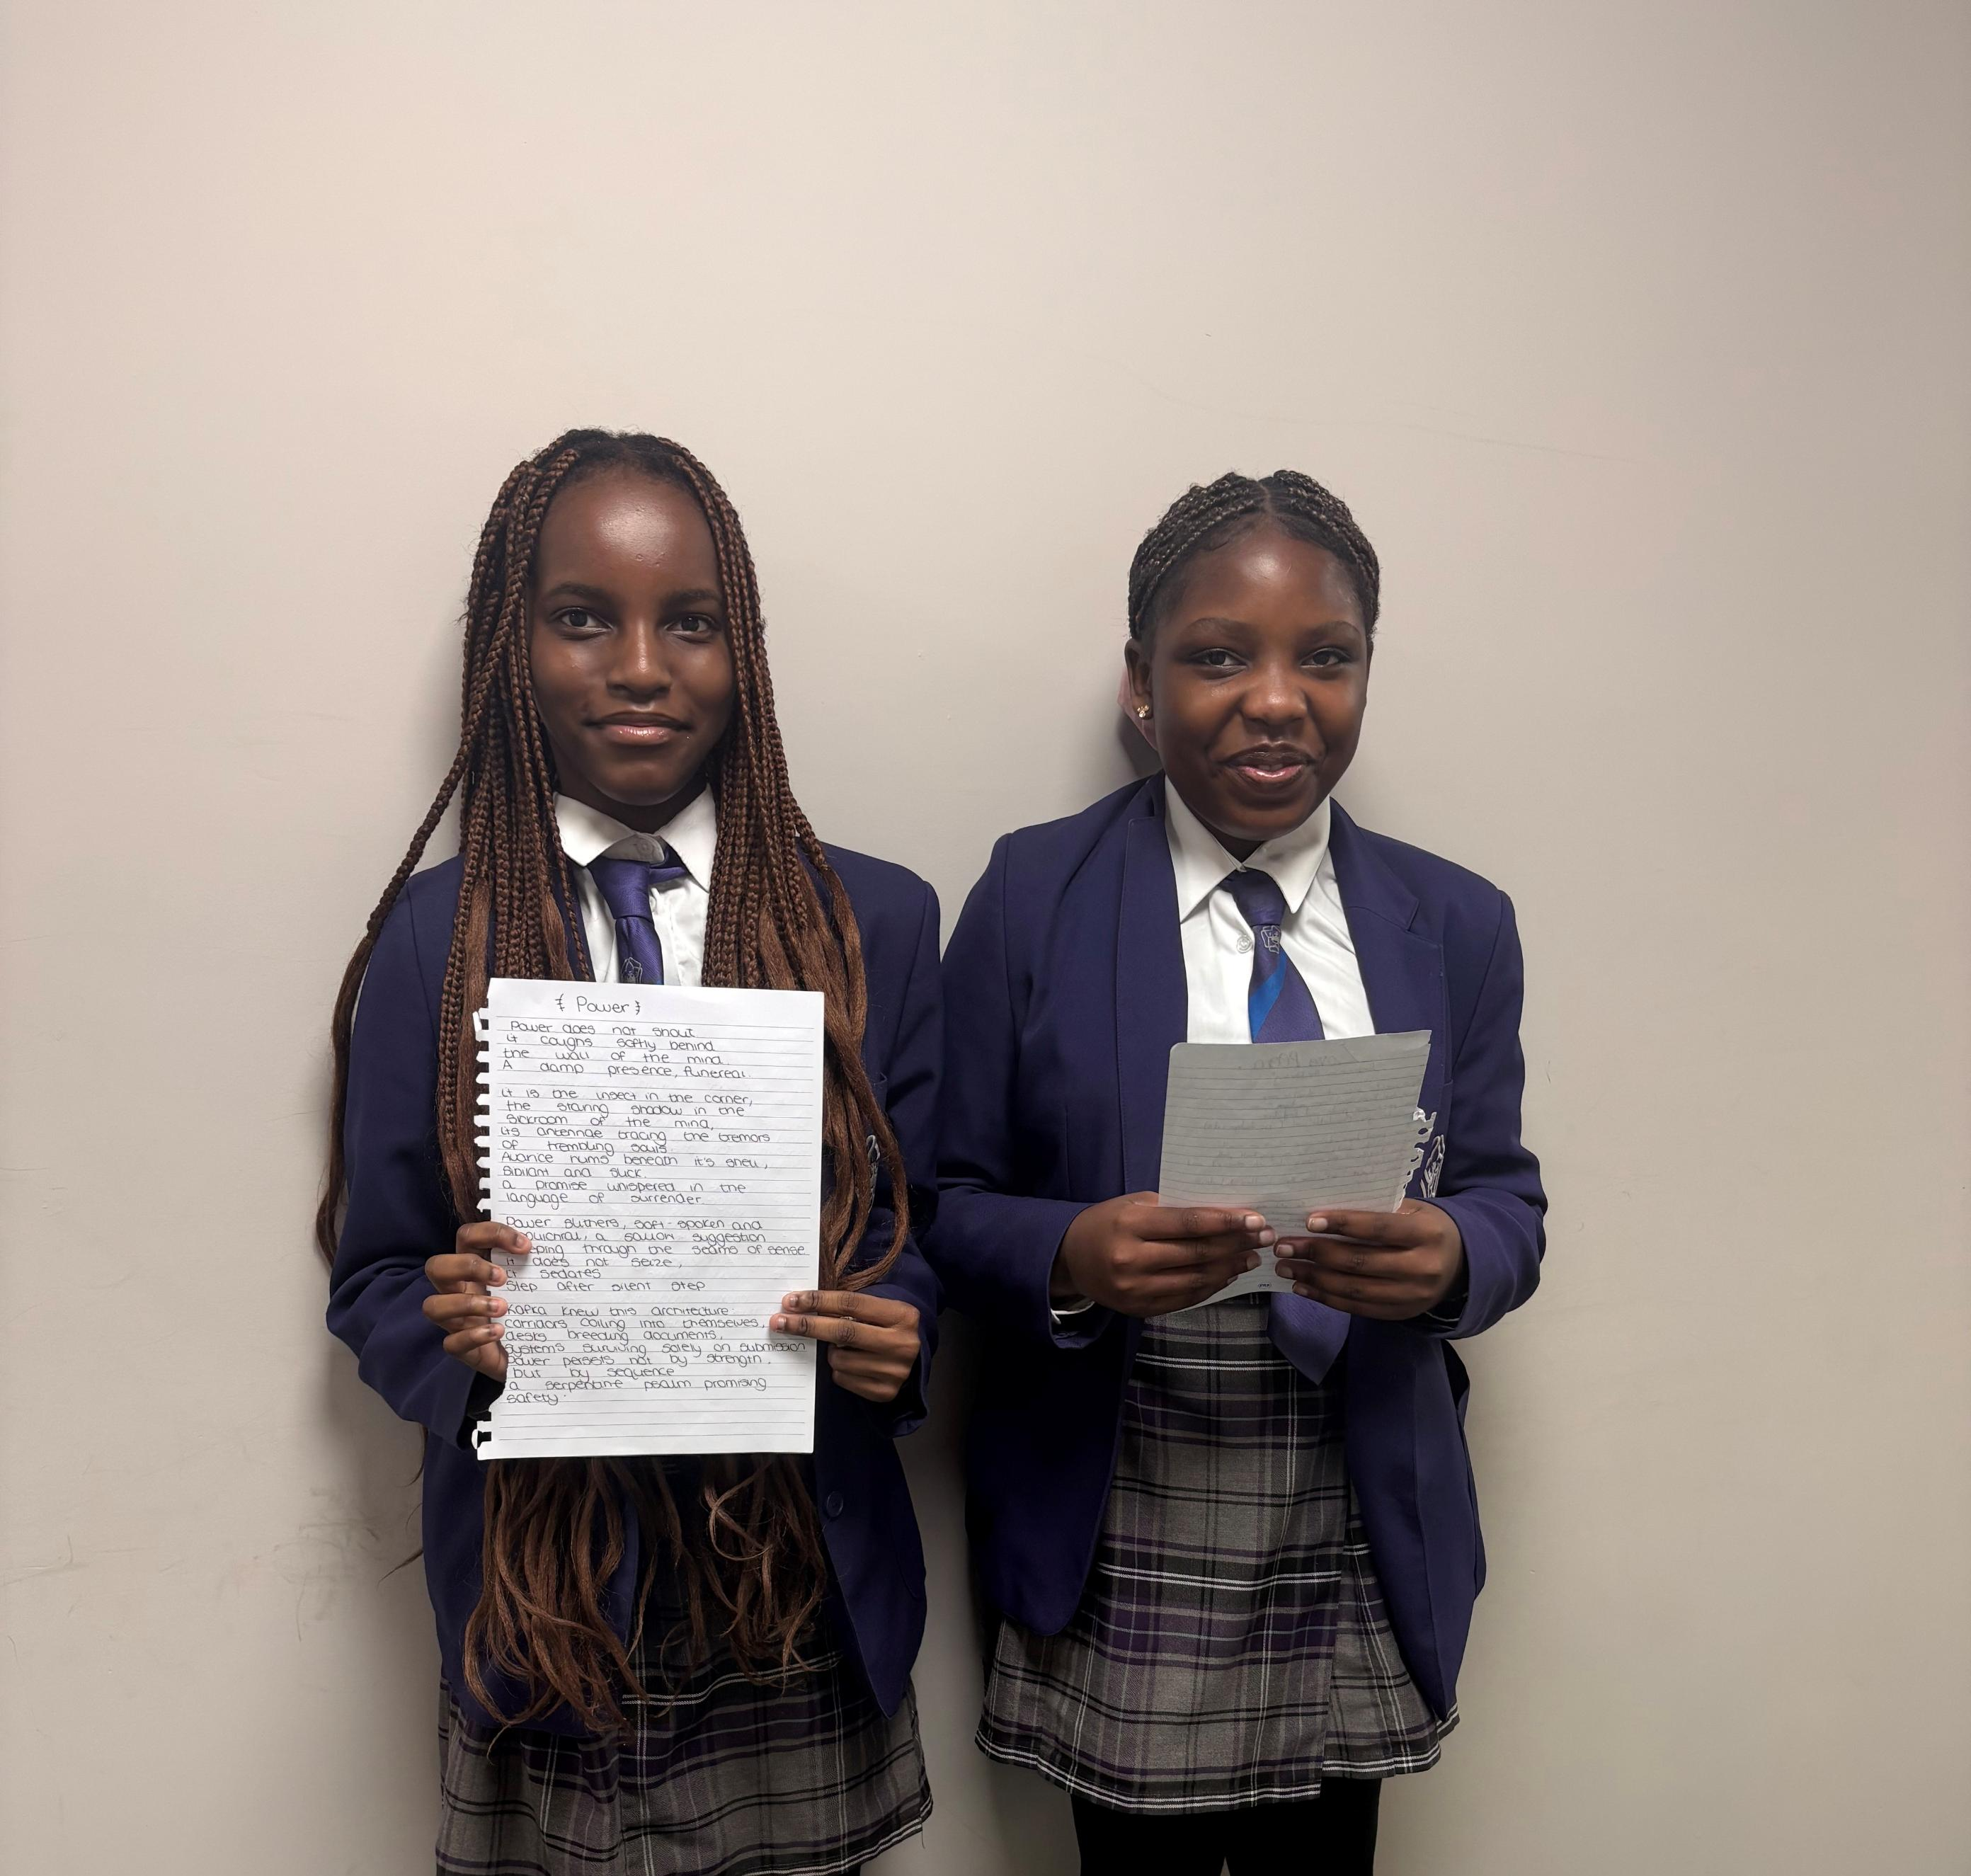
Poetry & Flash Fiction Results
Winner of the poetry competition was Marah Chikoore (Y8) Burghley
Winner of the flash fiction was
Maka Madyambwa (Y8)
Burghley
Huge Congratulations to both of you!
You will both be receiving your prizes & certificates in the year 8 assembly next week.

Slide 24
Poetry & Flash Fiction Results
The following students all score for entering a poem or story:
Henry Asare
Henrik Clocherty
Josh Partridge
Lucas Raper
Leander Rodrigues
Ava Howl Green
Alfie Hourd
Cass Fraser
Lily Burgess
Mya Gaynes
Freya Sweeney
Max Boswell
Alfie Lorentzen
Olivia Neilson
The runners up were:
Tanatswa Mutami, (Y9) Rockingham
Isla Richardson, (Y7) Rockingham
Joel Jenkin, (Y10) Burghley
Orla Bradley, (Y8) Talbot
Mia Garcia-Rowland, (Y10) Rockingham

Slide 25
House Attendance League By Year Group & House
TALBOT
Year 8 – 95.76%
LYVEDEN
Year 11 – 97.54%
BURGHLEY
Year 9 – 94.7%
ROCKINGHAM
Year 7 – 95.36%
Year 8 – 95.17%
Year 10 – 94.72%
Year 11 – 93.7%
Year 9 – 92.33%
Year 11 – 95.18%
Year 7 – 94.66%
Year 10 – 92.31%
Year 9 – 89.05%
Year 8 – 93.75%
Year 11 – 92.53%
Year 10 – 91.34%
Year 7 – 90.35%
Year 8 – 94.19%
Year 7 – 92.98%
Year 9 – 90.17%
Year 10 – 87.75%

Slide 26
House attendance league positions
1st - Rockingham – 93.95% - 100pts
2nd - Talbot – 93.44% - 75pts
3rd - Burghley – 92.75% - 50pts
4th - Lyveden – 92.23% -25pts

Slide 27

House Cup Standings
1ST – TALBOT – 2561
2ND – LYVEDEN – 2280
3RD – ROCKINGHAM – 1964
4TH – BURGHLEY - 1927

Slide 28

Extra Curricular Clubs and Interventions
Extra curricular clubs and academic interventions will begin again next Monday. A letter will be sent home on Friday detailing all opportunities available.
Your parents / guardians will need to sign you up for ANY extra curricular club or academic intervention via Arbor. You will not be able to attend if not registered.
If you have previously registered for or attended a club or afterschool intervention/ revision session you will need to RE REGISTER for this on Arbor at the start of each term.

Slide 29
The Prince William Perspective Needs You!
We want the PWP to be an opportunity for you to use your voice. If you have any ideas for new features for the bulletin, or things you would like to see in it please send them to pwp@pws.emat.uk

